Slide 1
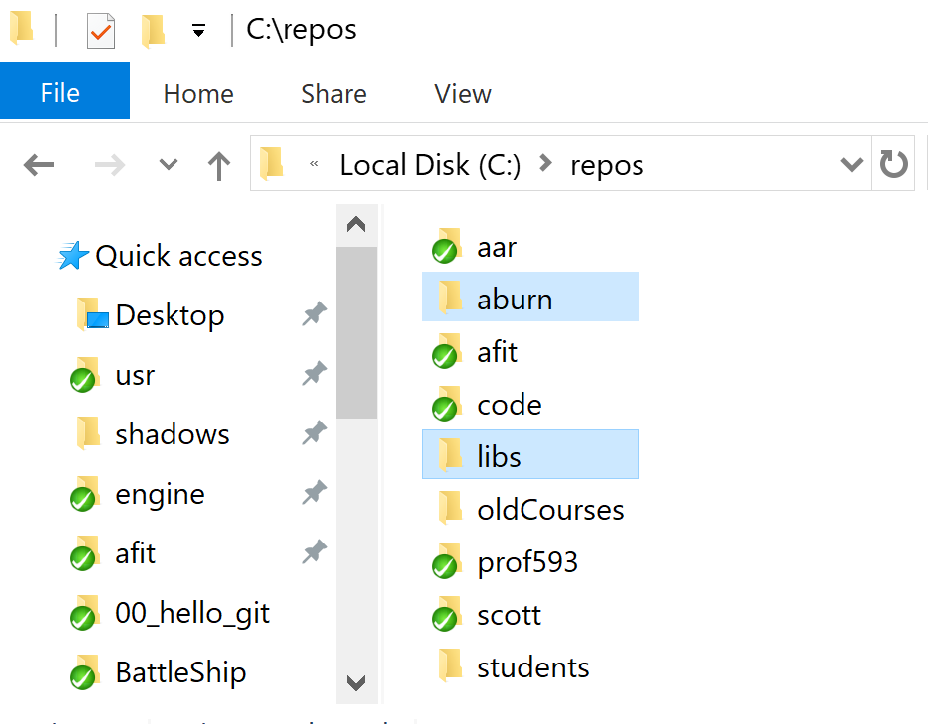
Unzip the .zip file
Extract from INSIDE C:\repos\
I.E Use 7-Zip and choose “Extract here”
When done you will have:
C:\repos\aburn\
C:\repos\libs\

Slide 2
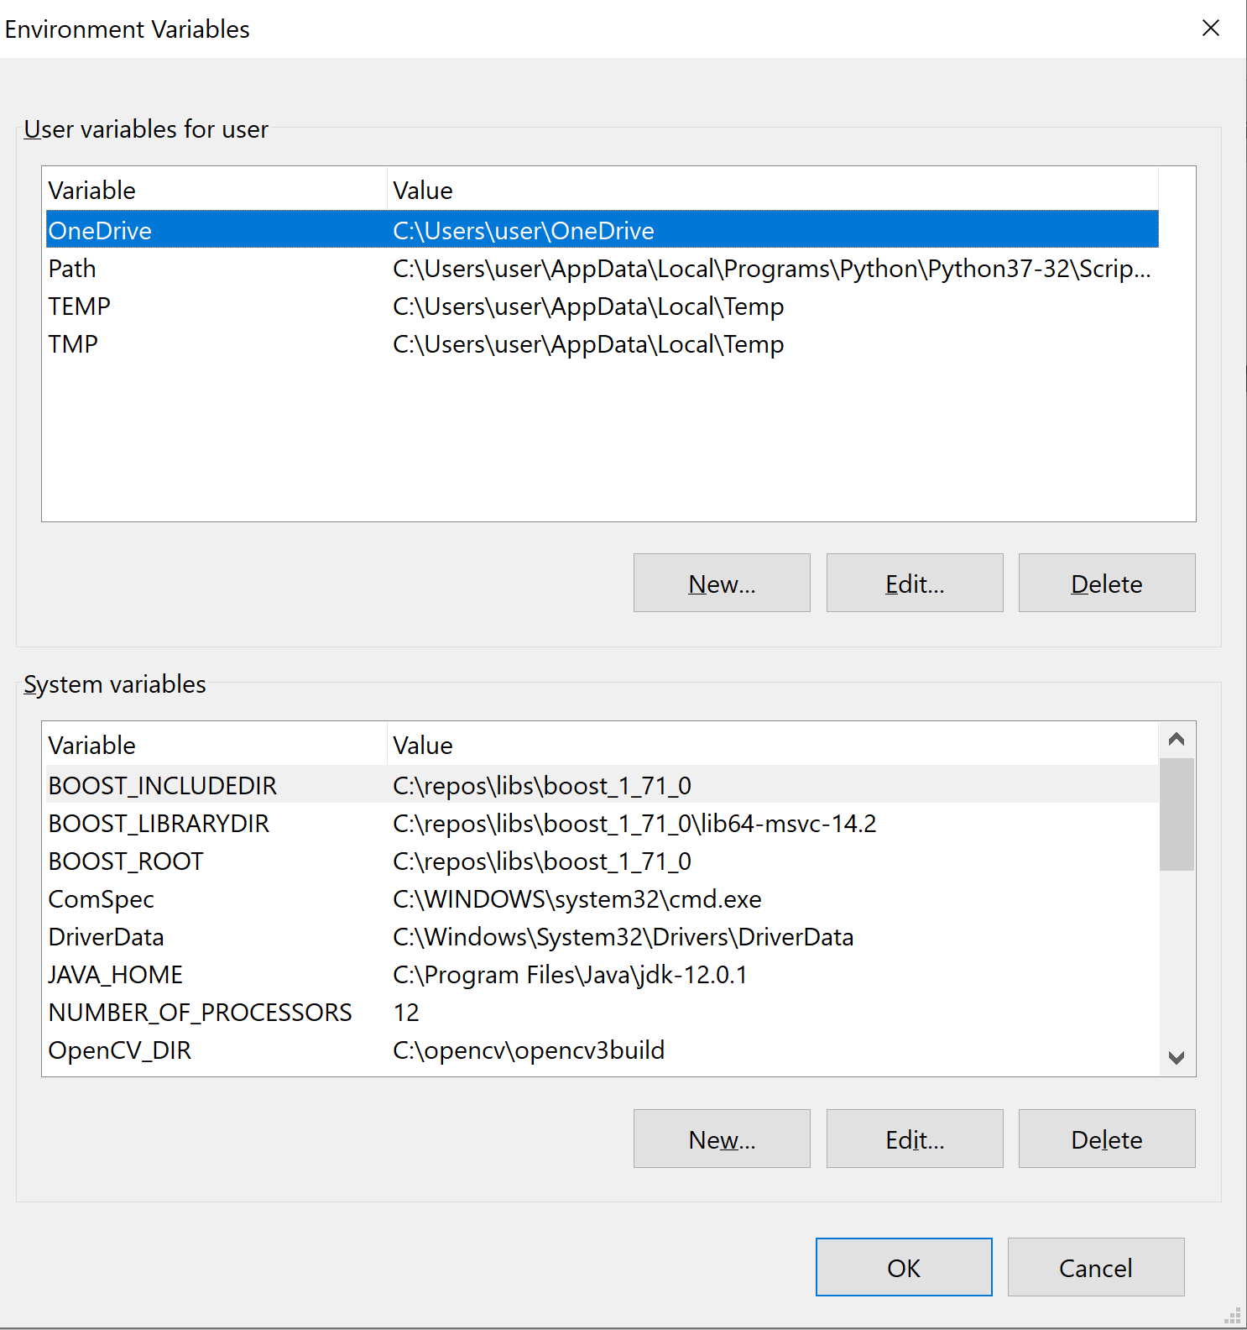
Set Environment Path for Boost
Control Panel → System → Advanced System Settings→ Environment Variables
BOOST_INCLUDEDIR=C:\repos\libs\boost_1_71_0
BOOST_ROOT=C:\repos\libs\boost_1_71_0
BOOST_LIBRARYDIR=C:\repos\libs\boost_1_71_0\lib64-msvc-14.2
Add the above System Vars

Slide 3
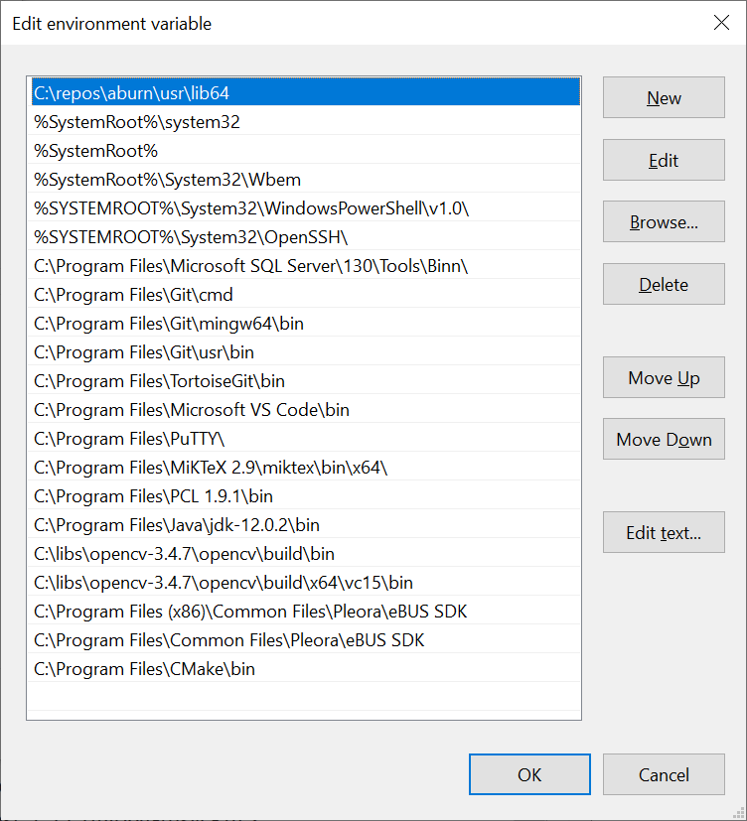
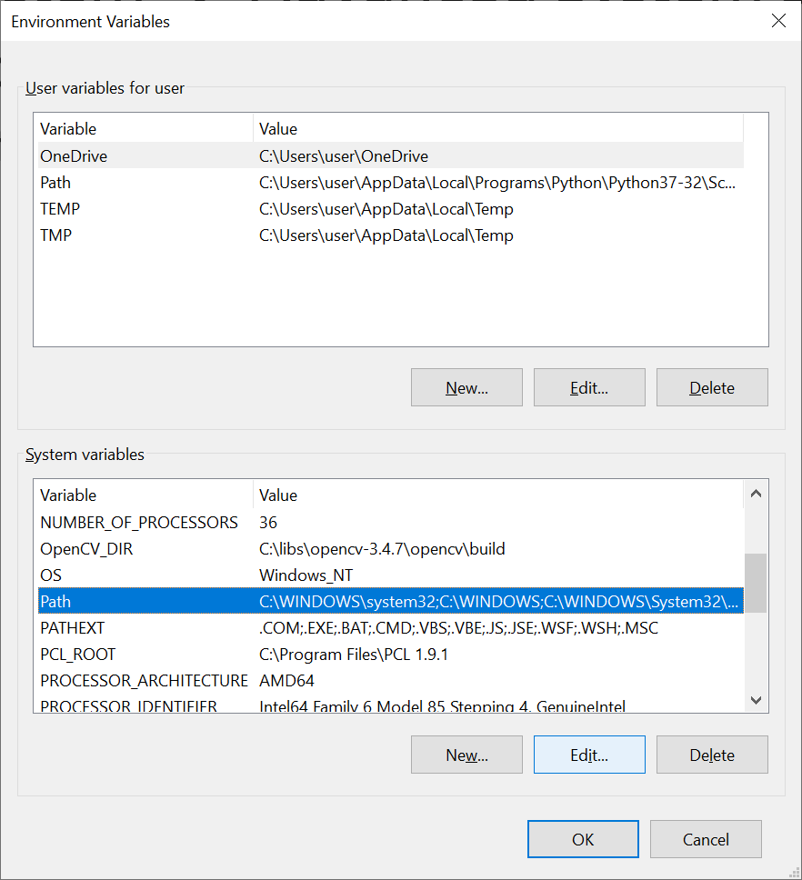
Set Environment Path to include usr/lib64
Control Panel → System → Advanced System Settings→ Environment Variables
Append to PATH C:\repos\aburn\usr\lib64

Slide 4
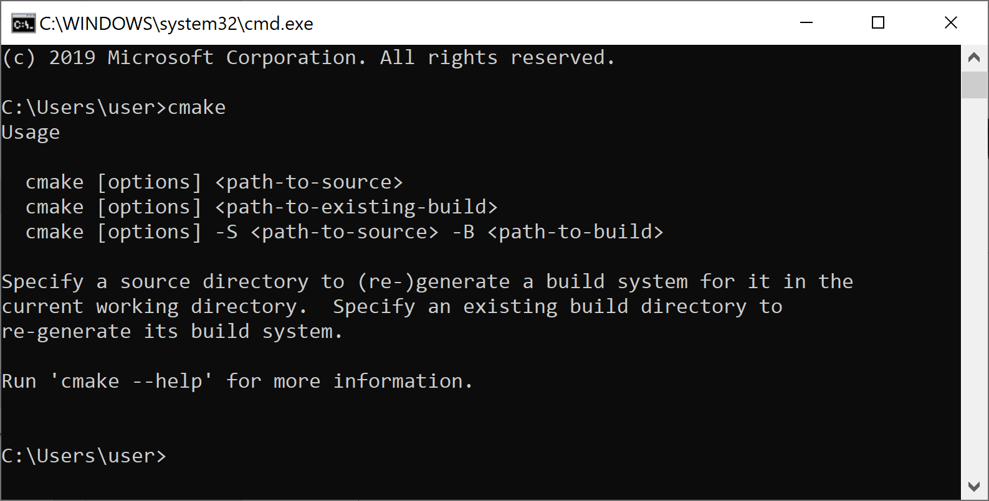
Ensure Cmake is installed and resides in your machine’s PATH

Slide 5
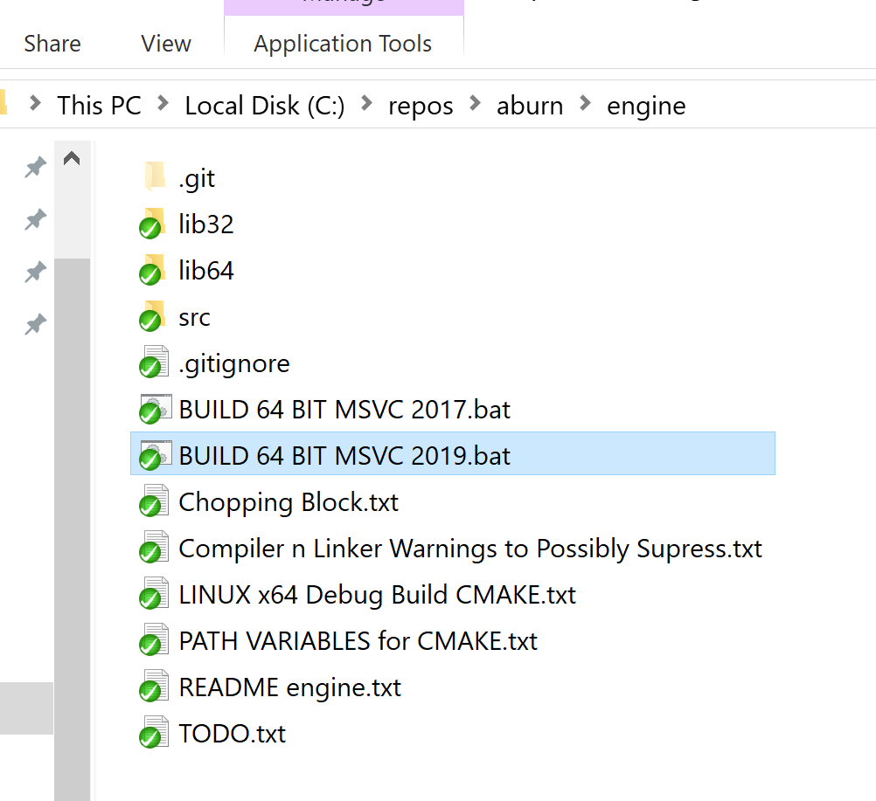
Build CMake .sln proj c:\repos\aburn\engine\
Run C:\repos\aburn\engine\BUILD 64 BIT MSVC 2019.bat
Open a CMD window or double click the .bat file

Slide 6
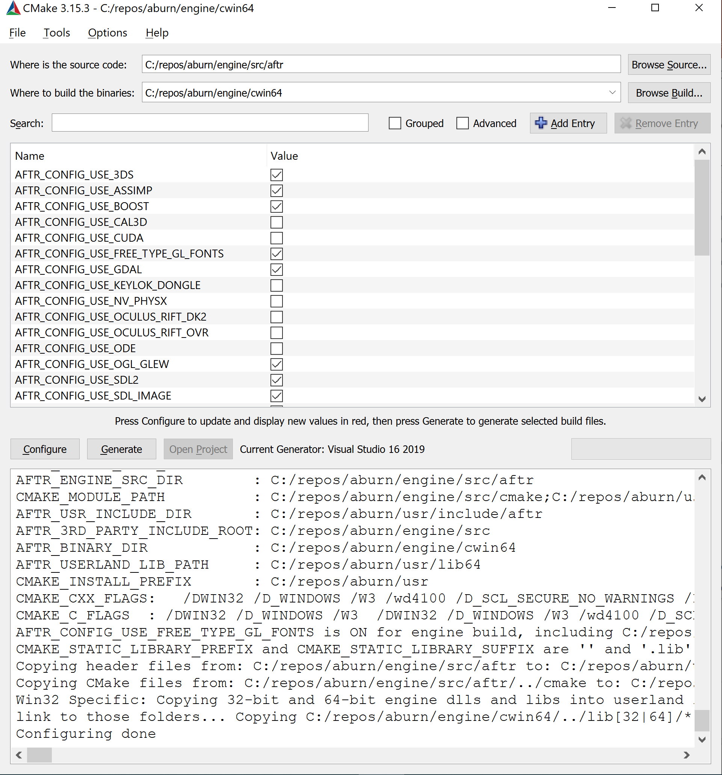
After the BAT finishes a cwin64 folder will exist
No need to do anything with this GUI (unless trouble shooting your build problem):

Slide 7
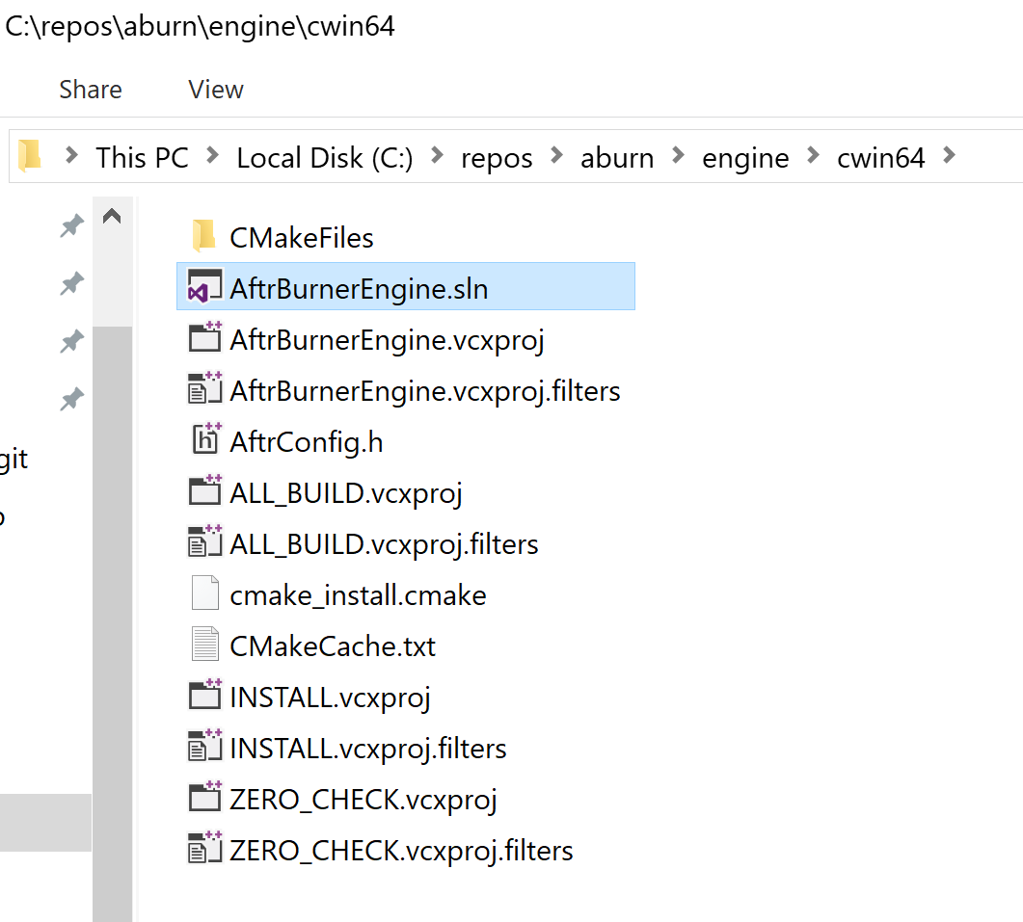
Open the .sln inside the cwin64 folder

Slide 8
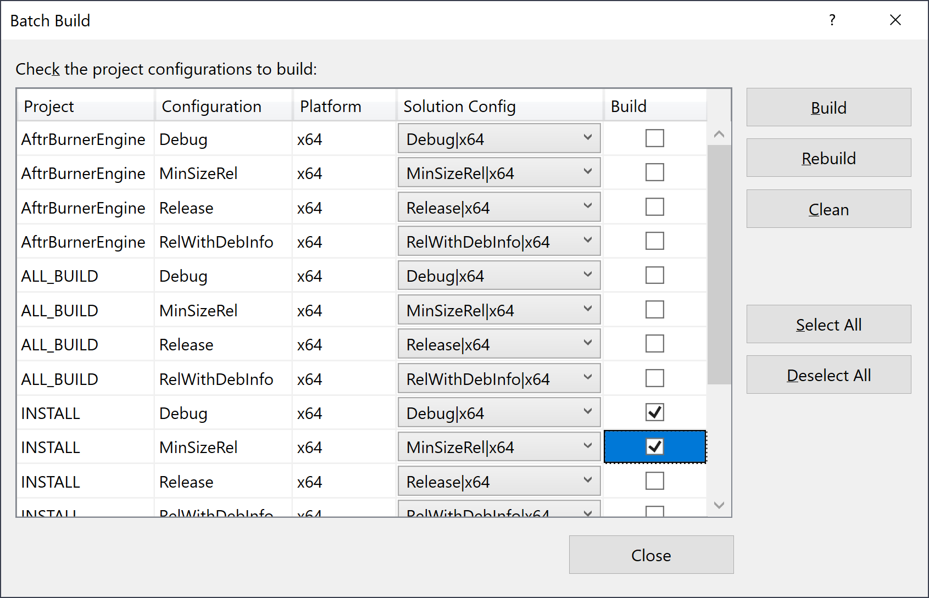
Build→Batch Build
Check INSTALL Debug and INSTALL MinSizeRel
Click Build

Slide 9
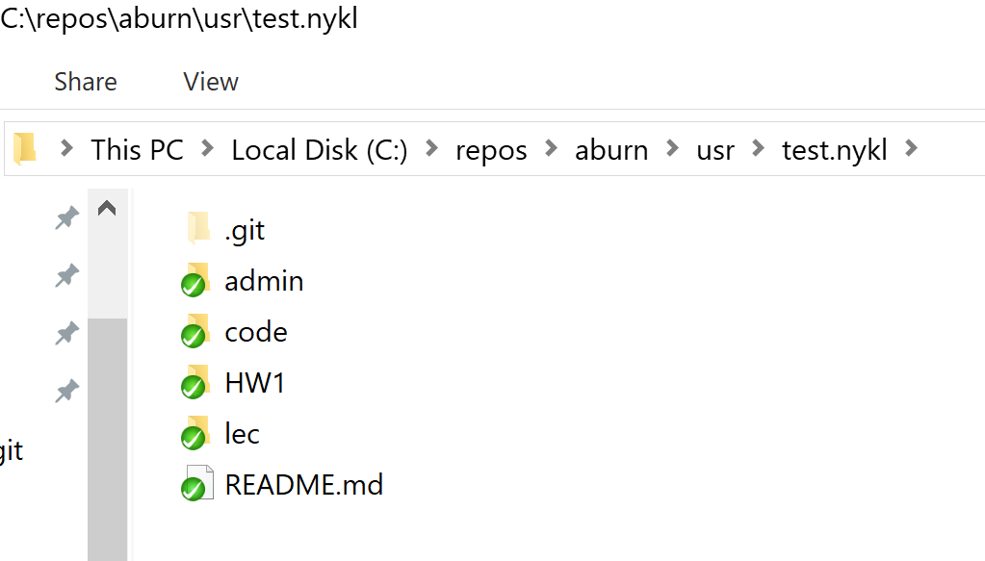
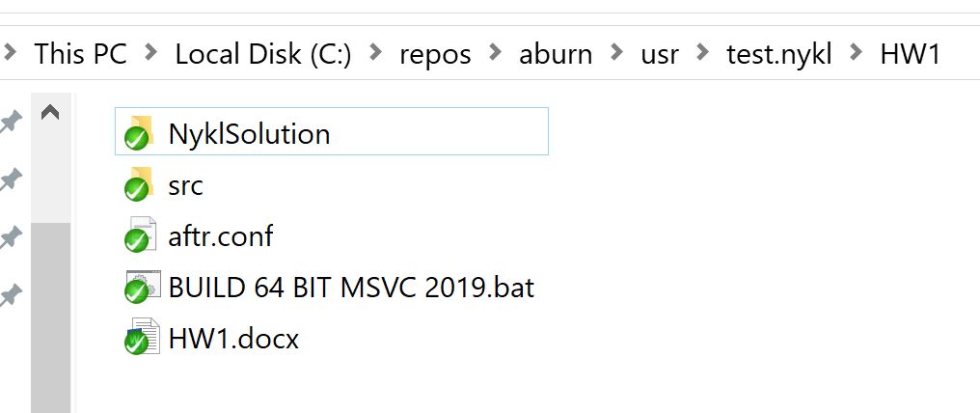
Move your csce593 repo to aburn/usr
Go into aburn/usr/your.repo/HW1 and Run .bat file

Slide 10
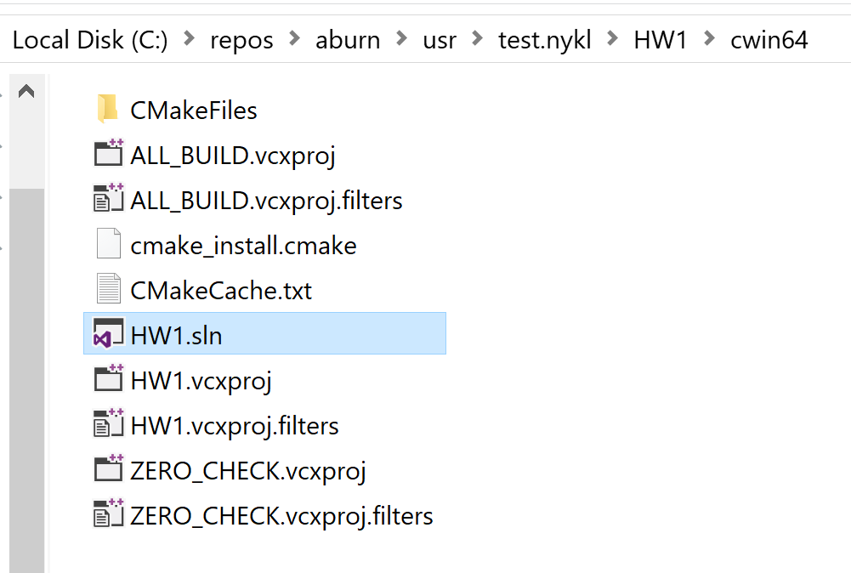
Enter aburn/usr/your.repo/HW1/cwin64
Open HW1.sln with MSVC 2019

Slide 11
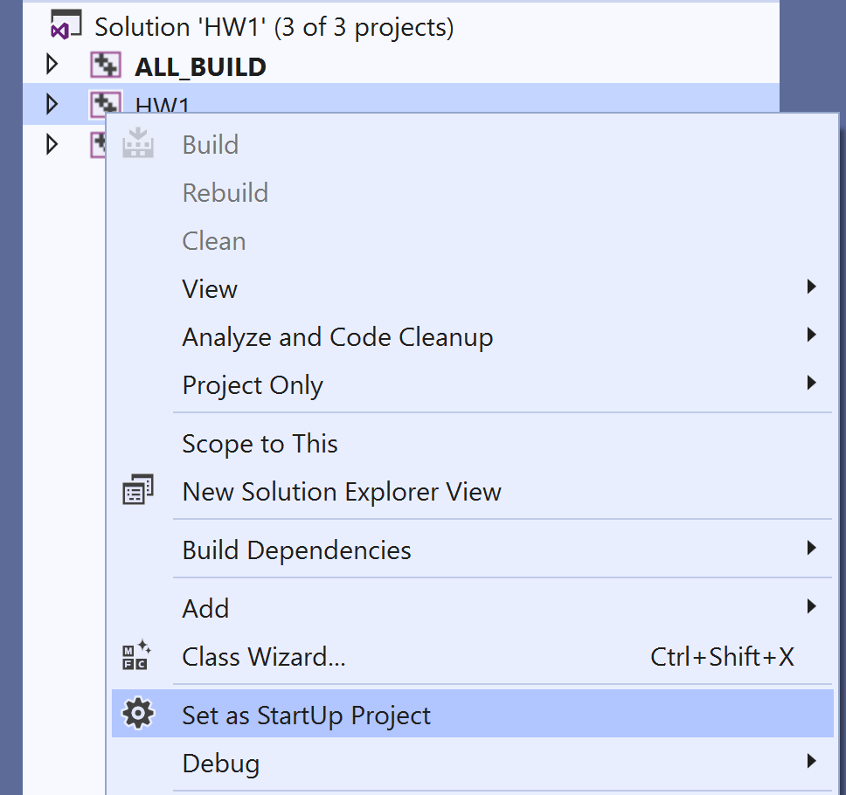
Set HW1 as Set as Startup Project

Slide 12
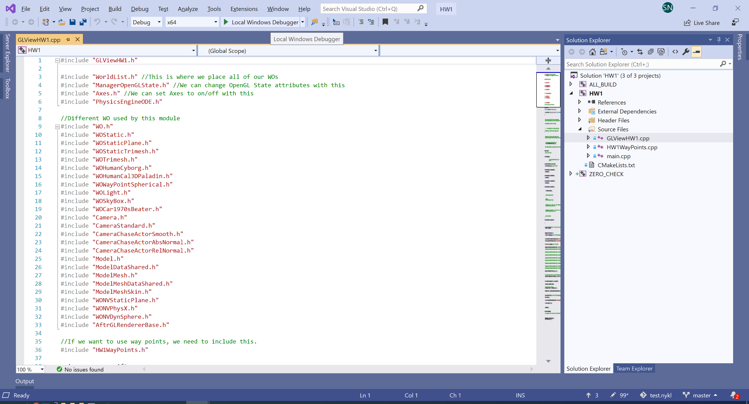
Compile and GO!

